Slide 1
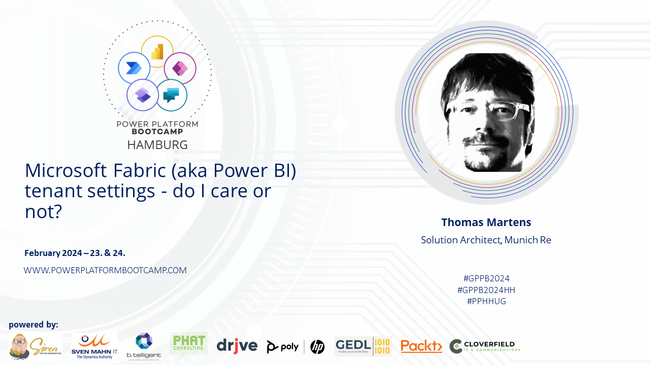
Microsoft Fabric Tenant Setting Do I care or not?!
Using Microsoft Fabric
Tom Martens @ Global Power Platform Bootcamp (Hamburg)
2024-02-24

Slide 2
Inside the box
Who I am
Admin Portal – the tenant settings (WTF?!)
Don’t loose sight

Slide 3

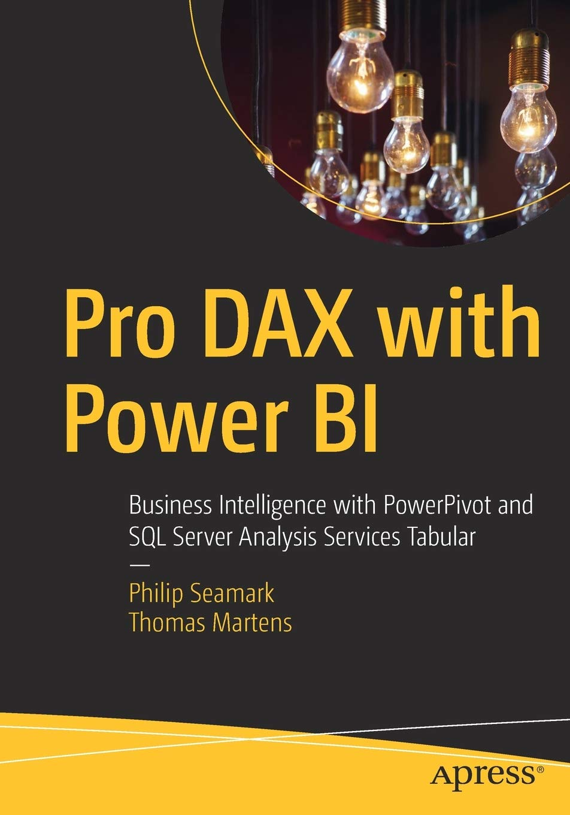

Tom Martens
25+ years of experience designing analytical solutions using the MSFT data platform
Solution Architect @ Munich Re
/tommartens68
@tommartens68

Slide 4

The settings?

Slide 5
What are tenant settings
Tenant settings enable fine-grained control over the features that are made available to your organization. If you have concerns around sensitive data, some of our features might not be right for your organization, or you might only want a particular feature to be available to a specific group.
https://learn.microsoft.com/en-us/fabric/admin/about-tenant-settings

Slide 6
What are tenant settings
Tenant settings enable fine-grained control over the features that are made available to your organization. If you have concerns around sensitive data, some of our features might not be right for your organization, or you might only want a particular feature to be available to a specific group.
https://learn.microsoft.com/en-us/fabric/admin/about-tenant-settings (I only added some colors to the text, and marked terms as bold)

Slide 7
What are tenant settings
Tenant settings enable fine-grained control over the features that are made available to your organization. If you have concerns around sensitive data, some of our features might not be right for your organization, or you might only want a particular feature to be available to a specific group.
https://learn.microsoft.com/en-us/fabric/admin/about-tenant-settings
(I only added some colors to the text, and marked terms as bold)

Slide 8
Wait there is more than the settings (I call it risk types)
Data Residency
Resource Consumption
Data Exfiltration
On February 24th, 2024 there were 119 settings!
Data Privacy
Data Literacy
Data Security

Slide 9



The groups!

Slide 10
Some words about Entra Id Groups
Use security Entra Id groups wherever possible, and your live as a Power BI Sherpa becomes more simple ☺
Think about a naming convention like
<location of the AD>-<type>-<service>-<scope>-<?workspace>-<domain>-<role/task> aad-fun-pbi-t-_-gateway-admin or aad-fun-pbi-t-_-dataset-AllowInPlaceDatasetSharing or aad-grp-pbi-g-testb2b-dsTestB2B-build or aad-grp-pbi-g-newDemo-app-aud_SeeSomething aad-grp-pbi-g-newDemo-app-aud_SeeEverything

Slide 11

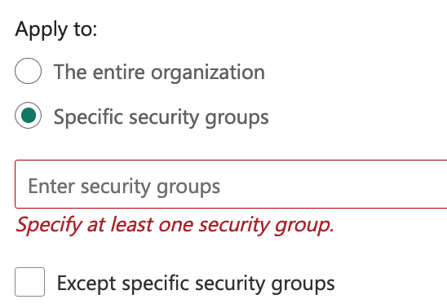
Consider wisely, how to add groups to your settings
Add individual security groups to the settings.
This enables simple control who is entitled to access a feature.

Slide 12

Consider wisely, how to add groups to your settings
Add a single central security group to the settings.
This allows
„productionizing“ of the membership and
allows other teams to check the membership easily

Slide 13

The solution! (at least a first draft)

Slide 14
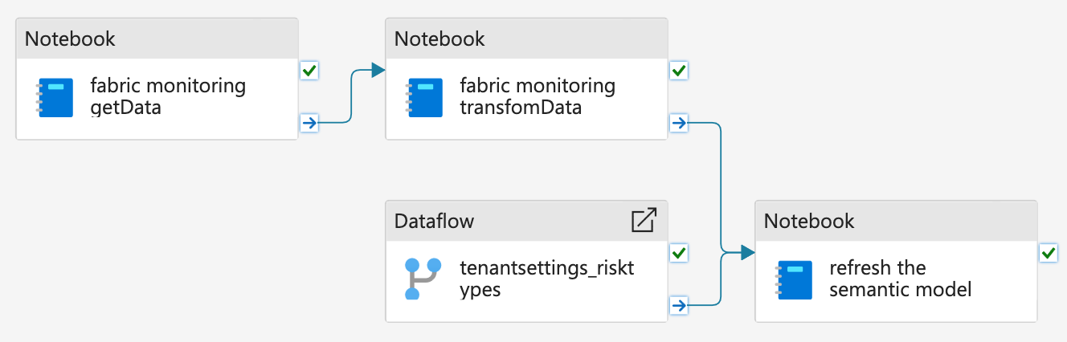
The pipeline

Slide 15


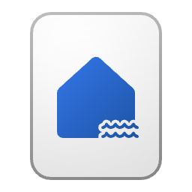

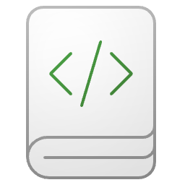


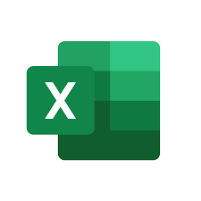

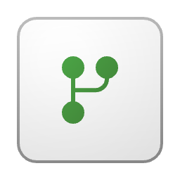
The overall architecture Schematic view
Pipeline
Lakehouse
Semantic Model
The Report
Delta Tables and JSON files

Slide 16

Something different! (maybe)

Slide 17

How to add a secret to a vault
Key Vault
Permission (inherited): User Access Administrator
It’s me (subscription contributor)
Permission (granted): Key Vault Secrets Officer
Permission (granted): Key Vault Secrets Officer
Someone else (the SPN)
Create/Read
Secret
Read

Slide 18
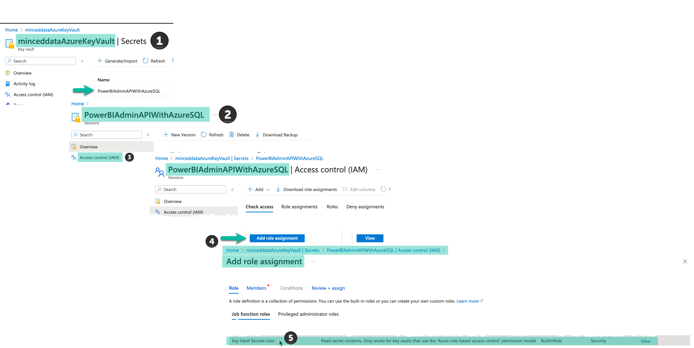
How to add a secret to a vault

Slide 19

Some readings

Slide 20
Resources
https://learn.microsoft.com/en-us/fabric/admin/about-tenant-settings
https://learn.microsoft.com/en-us/azure/key-vault/general/overview
https://learn.microsoft.com/en-us/fabric/

Slide 21



Resources
https://learn.microsoft.com/en-us/fabric/get-started/roles-workspaces

Slide 22
Thank you

